Slide 1
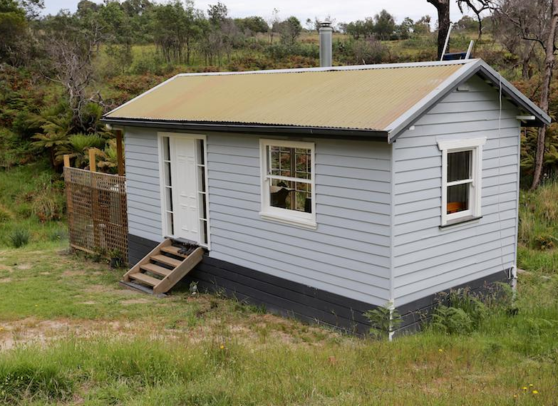
What’s it going to sell for?

Slide 2
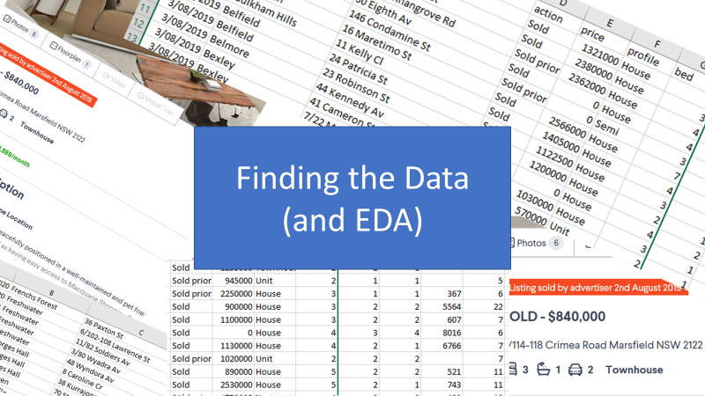
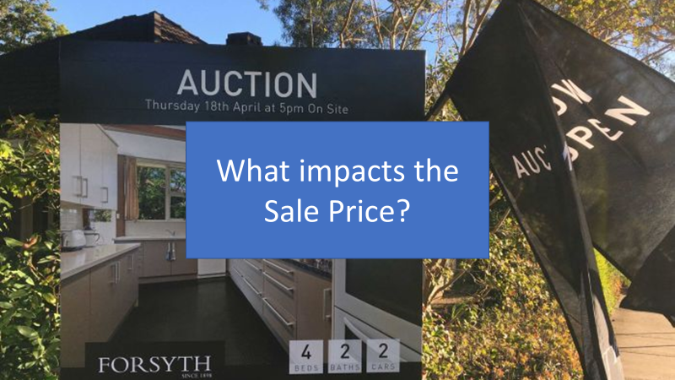



Slide 3
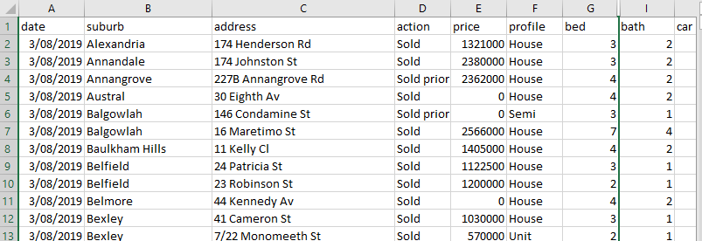
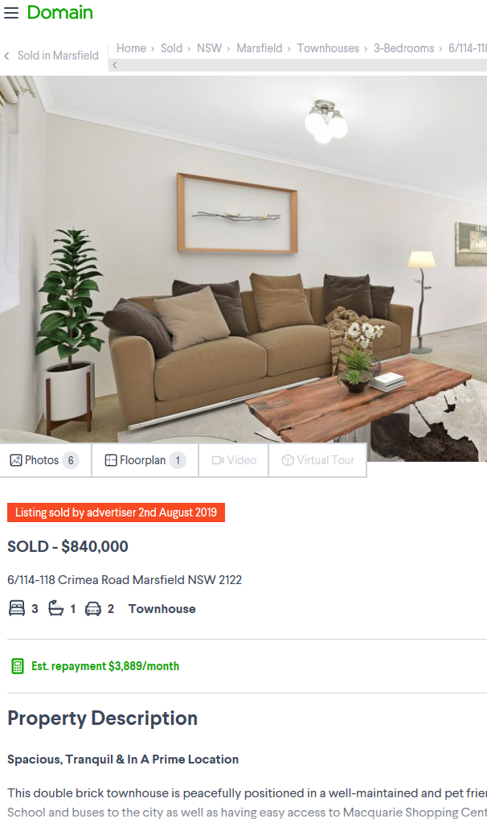
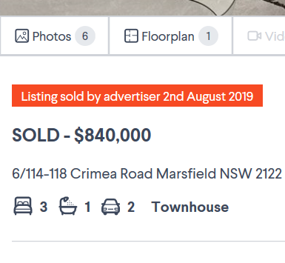
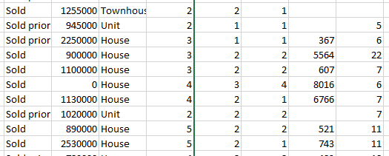
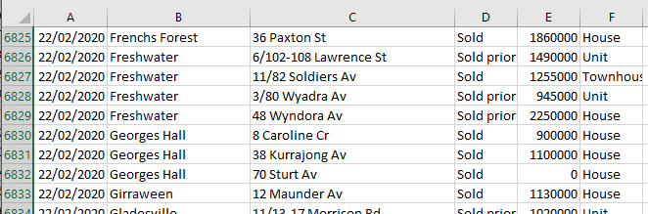
Finding the Data (and EDA)

Slide 4

Where is the data?
Pricing
Address
Details

Slide 5
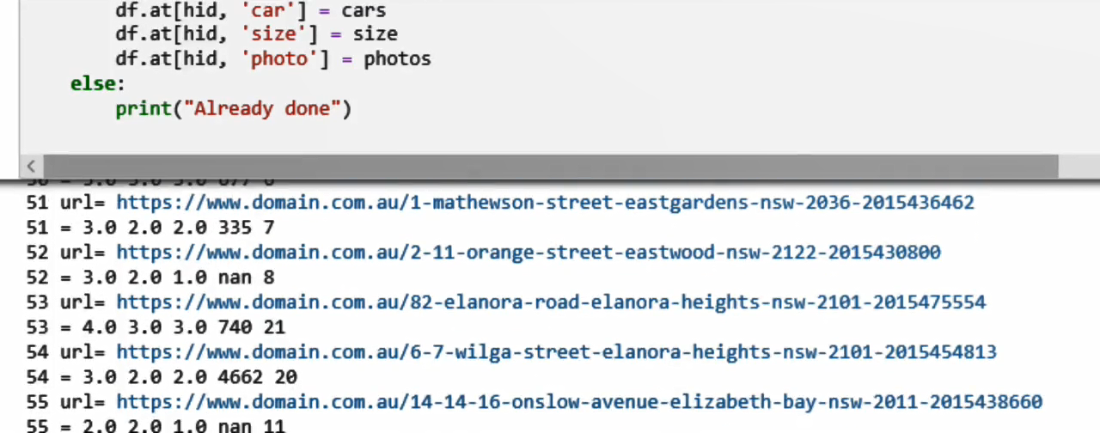
Where is the data?
Pricing
Address
Details
Scaping the data…

Slide 6
What we got…
Name | Type | Description
Date | Date | When the property was sold
Suburb | Text | Name of suburb (529 unique, 263 with more than 10 properties)
Action | Text | {Before, At, After} Auction
Price | int | From $310K to $8460K (2,288 missing)
Profile | Text | {House, Unit, Townhouse, Villa, Semi, Duplex, Terrace, Studio}
Beds | Int | 1 to 12 bedrooms
Baths | Int | 1 to 7 bathrooms (70 missing)
Car | Int | 1 to 9 car spaces (1,162 missing)
Size | Int | Size in m2 (largest 1M m2) (4,965 missing)
Photo | Int | 1 to 67 photos provided (1,040 missing)
10,989 records, 8,701 with price, 4,288 complete

Slide 7
Categorical to Numerical
Property type
Suburb
8 Unique values
Added column
Mean of price for property type
R² = 0.238
529 unique
263 with > 10 properties
Added column
Mean of suburb price
R² = 0.711

Slide 8
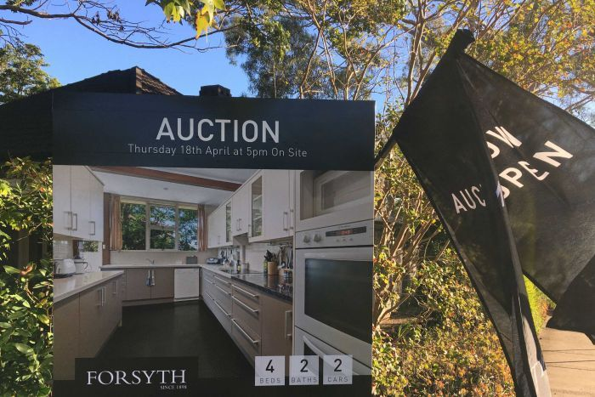
What impacts the Sale Price?

Slide 9
When property is sold affects price?
Before 98% certainty
$1,420,000 (n=2956 , σ=729K )
At auction 3.0% less than Before (n=4508 , μ=1,380K, σ=710K )
After 98% certainty
3% less than Before (n=71, μ=1,370K, σ=720K )

Slide 10
Location affects property price
All with >10 properties
Range $400K (Carramar) to $4,9230K (Linley Point)
Largest sample was Epping with 121 properties

Slide 11
Type of property affects price
Property Type | Mean value
Villa | $920K
Unit | $1,030K
Townhouse | $1,130K
Duplex | $1,190K
Semi | $1,450K
House | $1,570K
Terrace | $2,260K

Slide 12
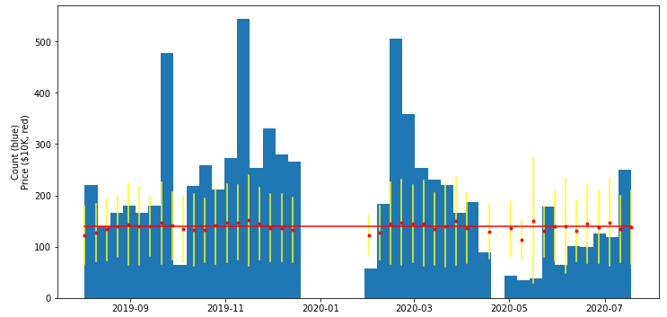
COVID-19 hasn’t affected price

Slide 13
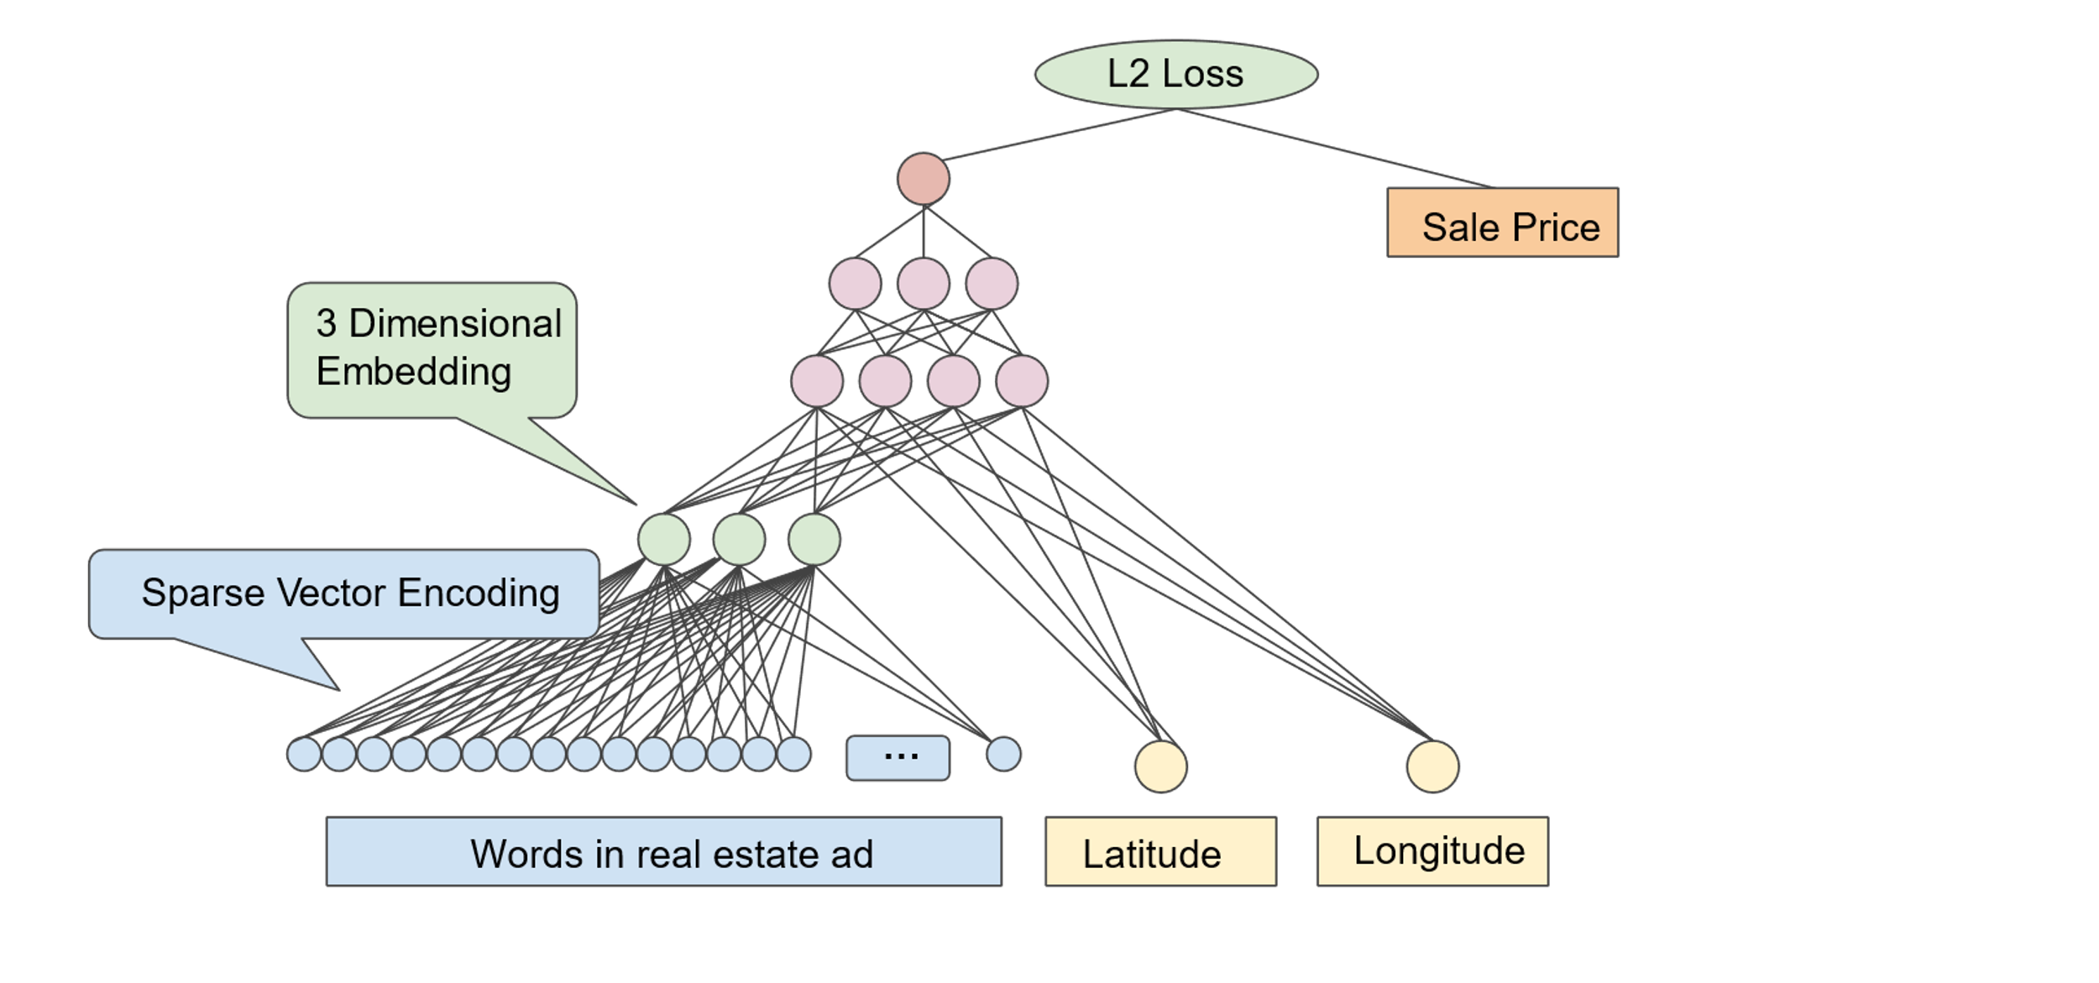
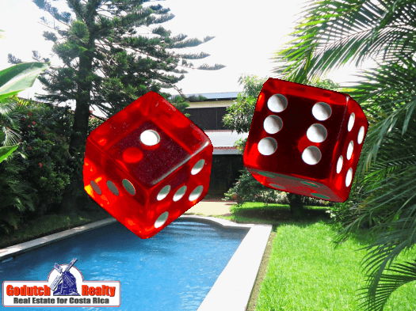
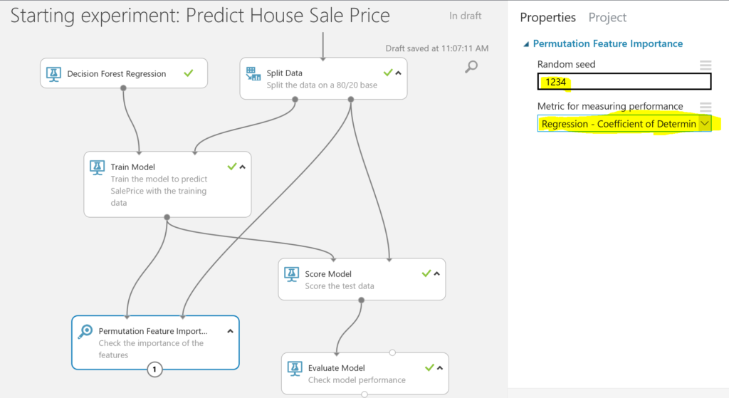

Can we predict the Sale Price?

Slide 14
Five steps
Start with your suburb
Add $120K for every bedroom
Add $32K for every photograph
Add the house profile value
Subtract $1,500K
Suburb | Add
Carramar | $433K
Claremont Md | Too little data
Epping | $1724K
Hornsby | $1344K
Manly | $2178K
Milson Point | $4072K
Sydney | $1367K
Surry Hills | $1448K
Vaucluse | $4262K
Zetland | $1226K
Property Type | Add
Villa | $506K
Unit | $550K
Townhouse | $613K
Duplex | $671K
Semi | $756K
House | $813K
Terrace | $968K

Slide 15

Example calculation
Suburb $1284
3 * Bedrooms $120 * 3 $360
6 * Photos $32 * 6 $192
Type of house $613
Less -$1500
Calculated valuation $949
Error $109
13%

Slide 16
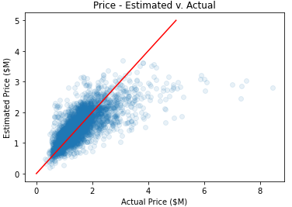
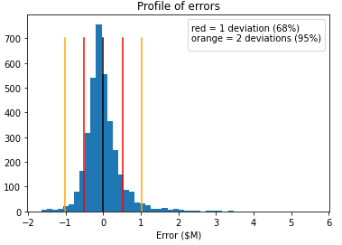
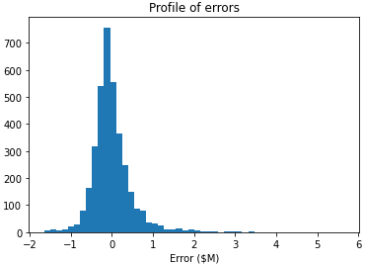
For Data Scientists Only
R = 0.725 so what is going on? Is our data OK?
0.725 sounds high but not really… we need > 0.95 for prediction
Error profile:
n=3594
μ=66K
σ=510K
68% in (-440K to 570K)
95% in (-950K to 1090K)
Slight skew in errors

Slide 17
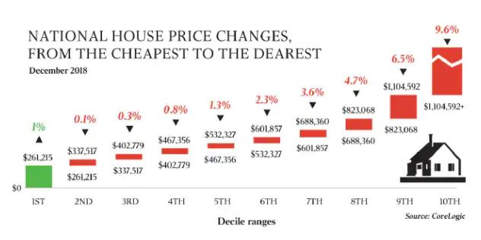

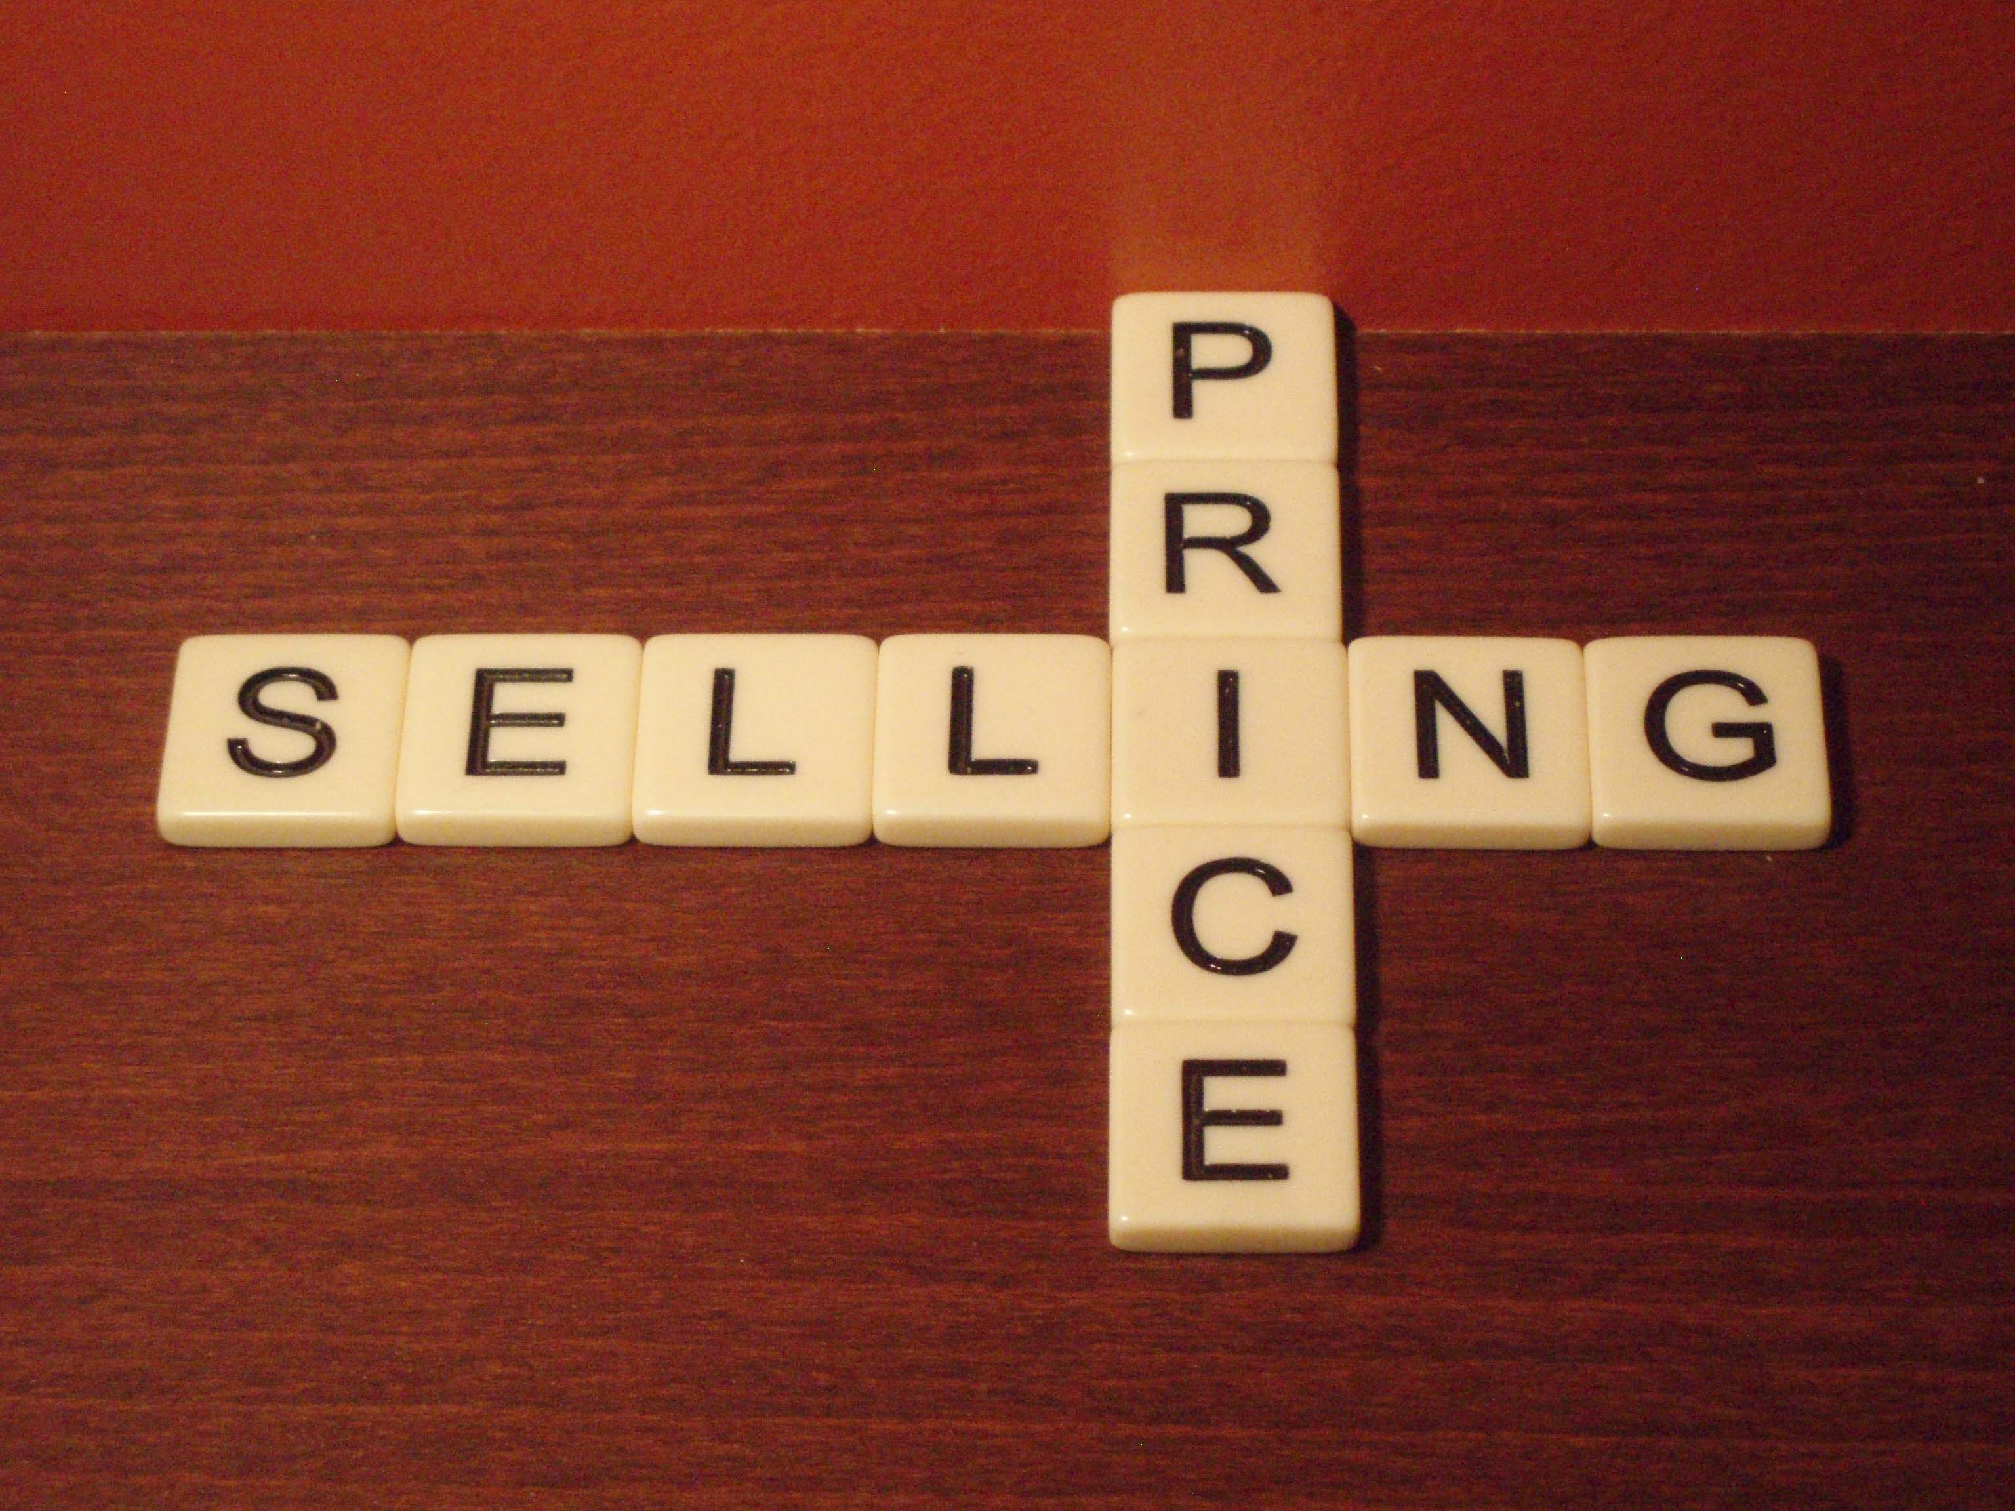
What have we discovered?

Slide 18
Summary of findings
Sell before auction
potential 3% uplift on value
Add a new bedroom
but only if it costs you less than $360K
Use lots of photos
each one is worth $32K
Predicting what your property will sell for
need more data

Slide 19
What to try it?
Head to:
https://github.com/briandorricott/DataScience-Exchange.git

